Slide 1
COMPILING – An Introduction

Slide 2
Why study compilers?
Bring together:
  Data structures & Algorithms
  Formal Languages
  Computer Architecture
Influence:
  Language Design
  Architecture (influence is bi-directional)
Techniques used influence other areas (program analysis, testing, …)

Slide 3
Compilers and Interpreters
“Compilation”
  Translation of a program written in a source language into a semantically equivalent program written in a target language
Input
Source
Program
Compiler
Target
Program
Error messages
Output

Slide 4
Compilers and Interpreters (cont’d)
“Interpretation”
  Performing the operations implied by the source program
Source
Program
Interpreter
Output
Input
Error messages

Slide 5
The Analysis-Synthesis Model of Compilation
There are two parts to compilation:
  Analysis determines the operations implied by the source program which are recorded in a tree structure
  Synthesis takes the tree structure and translates the operations therein into the target program

Slide 6
Other Tools that Use the Analysis-Synthesis Model
Structure Editors (syntax highlighting)
Pretty printers (e.g. doxygen)
Static checkers (e.g. lint and splint)
Interpreters
Text formatters (e.g. TeX and LaTeX)
Silicon compilers (e.g. VHDL)
Query interpreters/compilers (Databases)

Slide 7
Preprocessors, Compilers, Assemblers, and Linkers
Skeletal Source Program
Preprocessor
Source Program
Compiler
Target Assembly Program
Assembler
Relocatable Object Code
Linker
Libraries and
Relocatable Object Files
Absolute Machine Code

Slide 8
Compiler vs. Interpreter (1/5)
Compilers: Translate a source (human-writable) program to an executable (machine-readable) program
Interpreters: Convert a source program and execute it at the same time.

Slide 9
Compiler vs. Interpreter (2/5)
Source code
Compiler
Executable
Input data
Executable
Output data
Source code
Interpreter
Output data
Input data

Slide 10
Compiler vs. Interpreter (3/5)
Most languages are usually thought of as using either one or the other:
  Compilers: FORTRAN, COBOL, C, C++, Pascal, PL/1
  Interpreters: Lisp, scheme, BASIC, APL, Perl, Python, Smalltalk
BUT: not always implemented this way
  Virtual Machines (e.g., Java)
  Linking of executables at runtime
  JIT (Just-in-time) compiling

Slide 11
Compiler vs. Interpreter (4/5)
Actually, no sharp boundary between them. General situation is a combo:
Source code
Translator
Intermed. code
Intermed. code
Virtual machine
Output
Input Data
“Advanced Compiler Techniques”
Fall 2011

Slide 12
Compiler vs. Interpreter (5/5)
Compiler
Pros
  Less space
  Fast execution
Cons
  Slow processing
    Partly Solved
    (Separate compilation)
  Debugging
    Improved thru IDEs
Interpreter
Pros
  Easy debugging
  Fast Development
Cons
  Not for large projects
    Exceptions: Perl, Python
  Requires more space
  Slower execution
    Interpreter in memory all the time
“Advanced Compiler Techniques”
Fall 2011

Slide 13
Abstract view
Source
code
Compiler
Machine
code
errors
Recognizes legal (and illegal) programs
Generate correct code
Manage storage of all variables and code
Agreement on format for object (or assembly) code

Slide 14
Compilers: organization
Source
Frontend
Optimizer
Backend
Machine
code
IR
IR
Frontend
  Dependent on source language
  Lexical analysis
  Parsing
  Semantic analysis (e.g., type checking)

Slide 15
Compilers: organization (cont’d)
Source
Frontend
Optimizer
Backend
Machine
code
IR
IR
Optimizer
  Independent part of compiler
  Different optimizations possible
  IR to IR translation
  Can be very computational intensive part

Slide 16
Compilers: organization (cont’d)
Source
Frontend
Optimizer
Backend
Machine
code
IR
IR
Backend
  Dependent on target processor
  Code selection
  Code scheduling
  Register allocation
  Peephole optimization

Slide 17
Compiler Modularity
Lexical Analyzer
(Scanner)
Syntax Analyzer
(Parser)
Symantic Analyzer
Front End
Intermediate Code
Generator
Optimizer
Back End
Code Generator

Slide 18
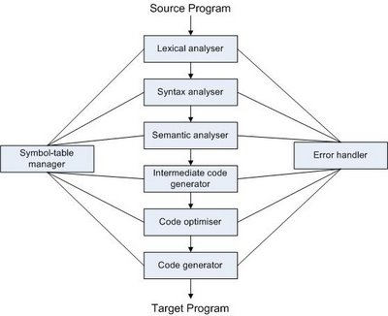

Slide 19
Front end
Source
code
Scanner
tokens
Parser
IR
errors
Scanner:
  Maps characters into tokens – the basic unit of syntax
    x = x + y becomes <id, x> = <id, x> + <id, y>
  Typical tokens: number, id, +, -, *, /, do, end
  Eliminate white space (tabs, blanks, comments)
A key issue is speed

Slide 20
Front end
Source
code
Scanner
tokens
Parser
IR
errors
Parser:
  Recognize context-free syntax
  Guide context-sensitive analysis
  Construct IR
  Produce meaningful error messages
  Attempt error correction
There are parser generators like YACC which automates much of the work

Slide 21
The Phases of a Compiler
Phase | Output | Sample
Programmer | Source string | A=B+C;
Scanner (performs lexical analysis) | Token string | ‘A’, ‘=’, ‘B’, ‘+’, ‘C’, ‘;’ And symbol table for identifiers
Parser (performs syntax analysis based on the grammar of the programming language) | Parse tree or abstract syntax tree | ; | = / \ A + / \ B C
Semantic analyzer (type checking, etc) | Parse tree or abstract syntax tree
Intermediate code generator | Three-address code, quads, or RTL | int2fp B t1 + t1 C t2 := t2 A
Code Optimizer | Three-address code, quads, or RTL | int2fp B t1 + t1 #2.3 A
Code generator | Assembly code | MOVF #2.3,r1 ADDF2 r1,r2 MOVF r2,A
Peephole optimizer | Assembly code | ADDF2 #2.3,r2 MOVF r2,A

Slide 22
The Grouping of Phases
Compiler front and back ends:
  Analysis (machine independent front end)
  Synthesis (machine dependent back end)
Passes
  A collection of phases may be repeated only once (single pass) or multiple times (multi pass)
  Single pass: usually requires everything to be defined before being used in source program
  Multi pass: compiler may have to keep entire program representation in memory

Slide 23
Compiler-Construction Tools
Software development tools are available to implement one or more compiler phases
  Scanner generators
  Parser generators
  Syntax-directed translation engines
  Automatic code generators
  Data-flow engines

Slide 24
Symbol Table Management

Slide 25
Error Detection and Reporting

Slide 26
Lexical Analysis

Slide 27
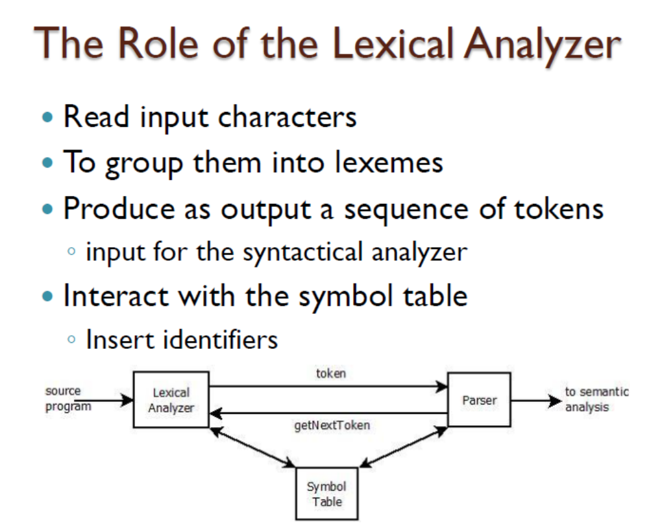


Slide 28
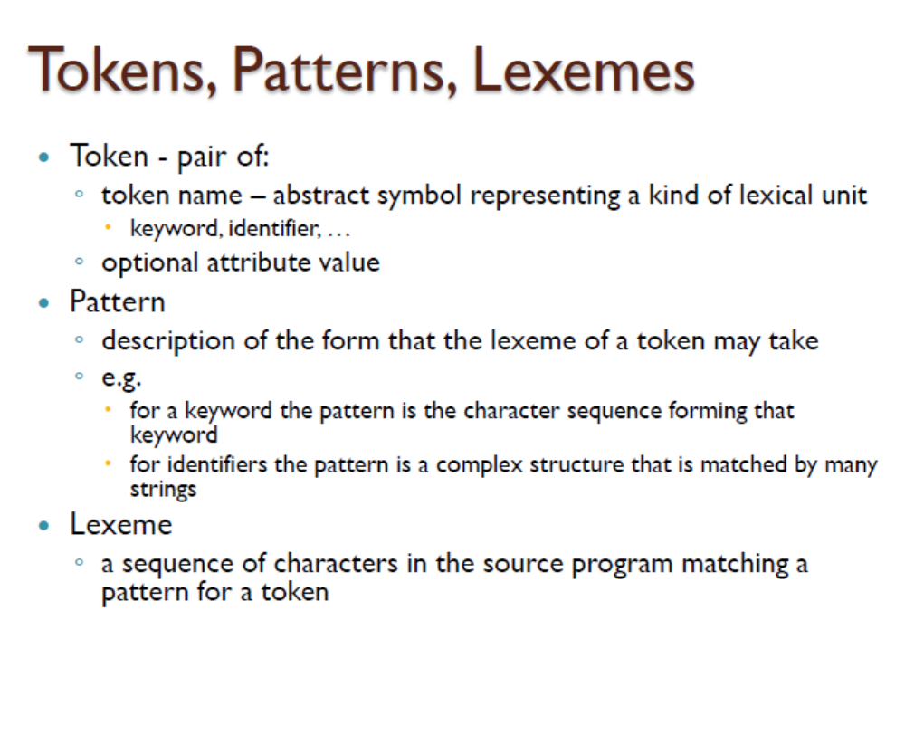

Slide 29
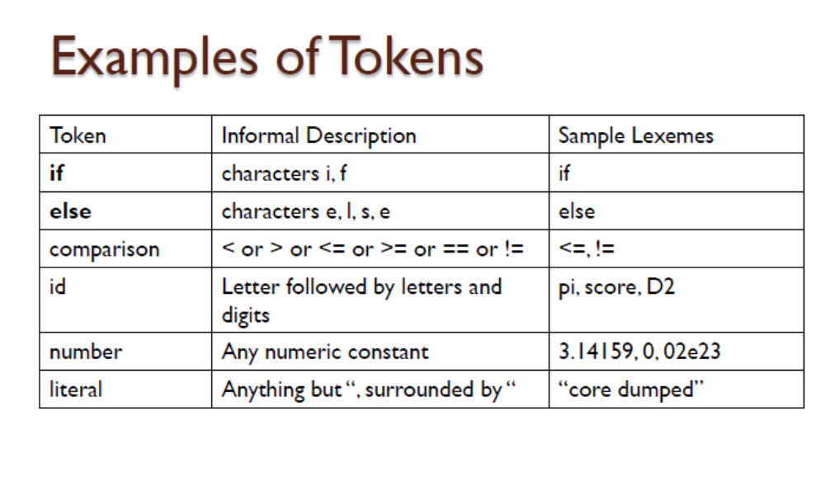

Slide 30
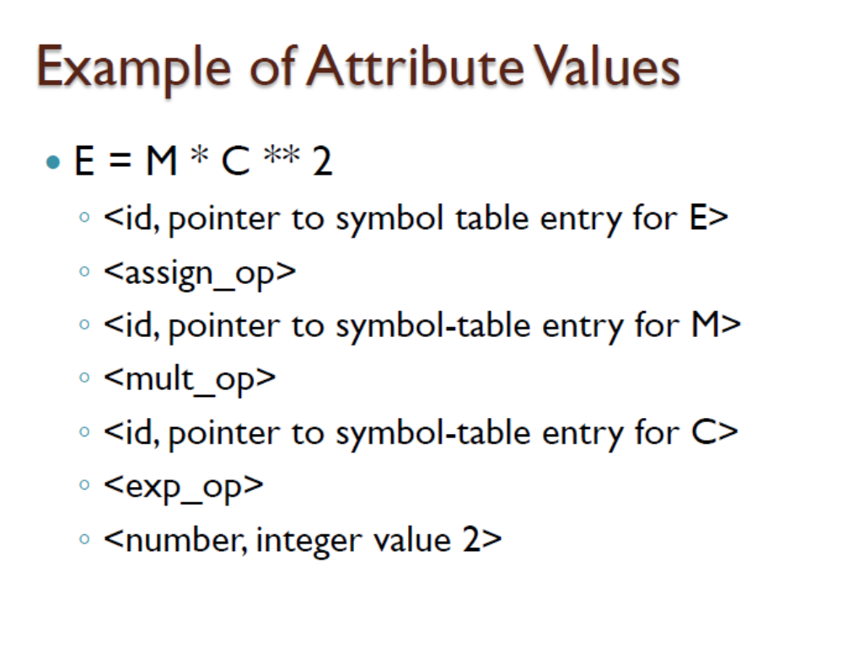

Slide 31
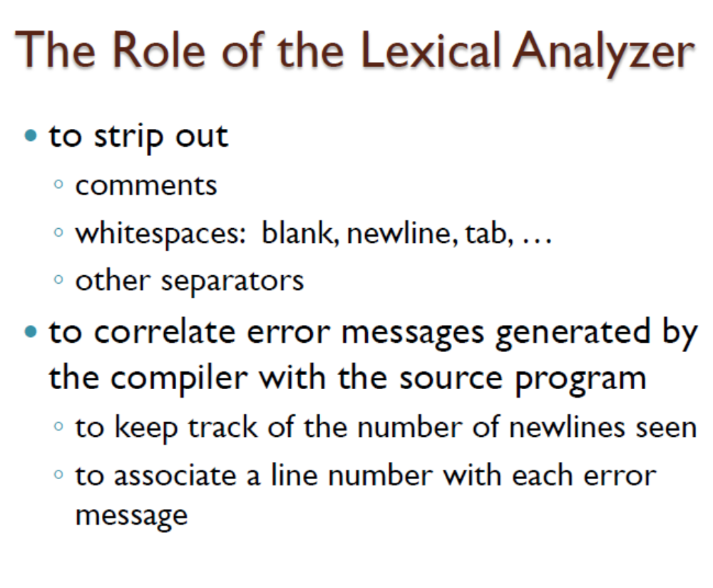

Slide 32
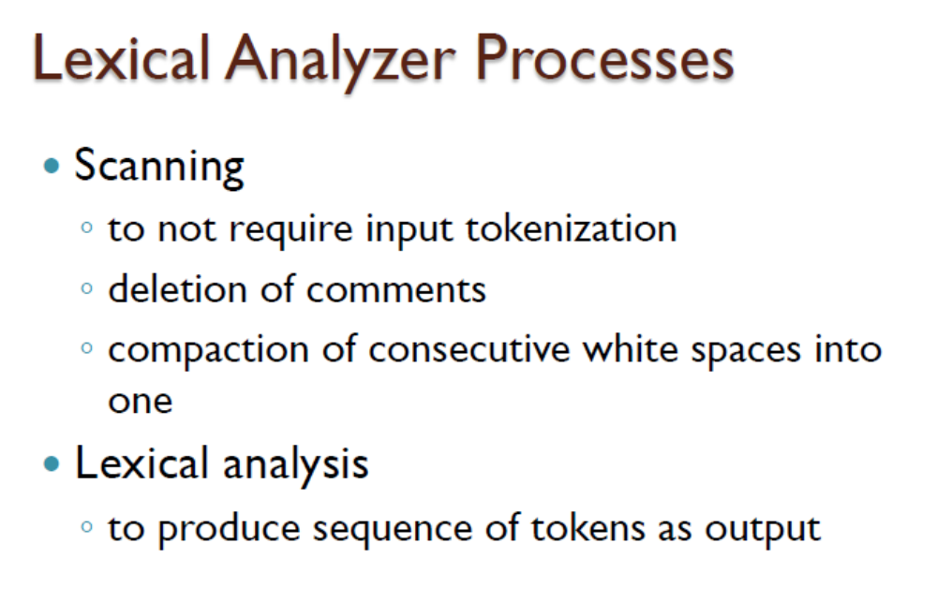

Slide 33
Input Buffering
Two – Buffer Input scheme
Sentinel Pairs

Slide 34
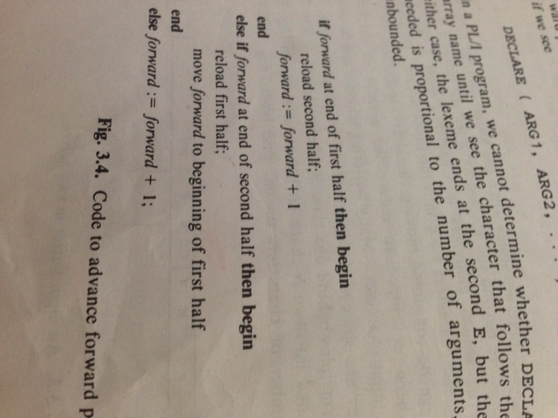

Slide 35
Lookahead Code with Sentinels
switch (*forward++) {
case eof:
if (forward is at end of first buffer) {
reload second buffer;
forward = beginning of second buffer;
}
else if (forward is at end of second buffer) {
reload first buffer;
forward = beginning of first buffer;
}
else
/* eof within a buffer marks the end of inout */
terminate lexical anaysis;
break;
cases for the other characters;
}

Slide 36
Specification of Tokens
Languages
Regular Expressions

Slide 37
Recognition of Tokens
Transition Diagrams

